Slide 1
Selenium IDE tests-Ram your brains!!!!!
Assert/verify title- Only Testing: Selectable
http://only-testing-blog.blogspot.com/2014/09/selectable.html
Assert value-Cancel button
http://only-testing-blog.blogspot.com/2014/05/login.html
Assert text-’Double Click Me To See Alert’ button
http://only-testing-blog.blogspot.com/2014/09/selectable.html
Assert element present -fname, lname
Assert element not present -qname
http://only-testing-blog.blogspot.com/2014/06/alert_6.html
Assert whether a single check box is clicked or not https://www.seleniumeasy.com/test/basic-checkbox-demo.html
Assert editable- firstname textbox
http://only-testing-blog.blogspot.com/2014/06/alert_6.html
Radio buttons- select radio button ‘Female’ and assert whether it was selected or not
https://www.seleniumeasy.com/test/basic-radiobutton-demo.html
Assert text - click ‘bootstrap-duallist’ and assert its text
https://www.seleniumeasy.com/test/bootstrap-dual-list-box-demo.html
Select Friday from drop down list and assert it.
https://www.seleniumeasy.com/test/basic-select-dropdown-demo.html
Assert alert, confirmation and prompt.
https://www.seleniumeasy.com/test/javascript-alert-box-demo.html

Slide 2
http://automationpractice.com/index.php

Slide 3
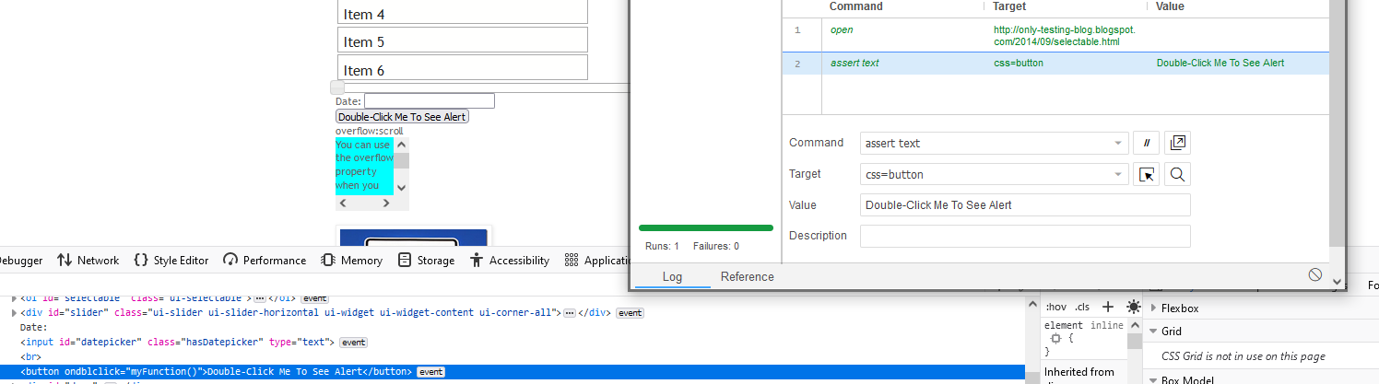
3. Assert text
http://only-testing-blog.blogspot.com/2014/09/selectable.html

Slide 4
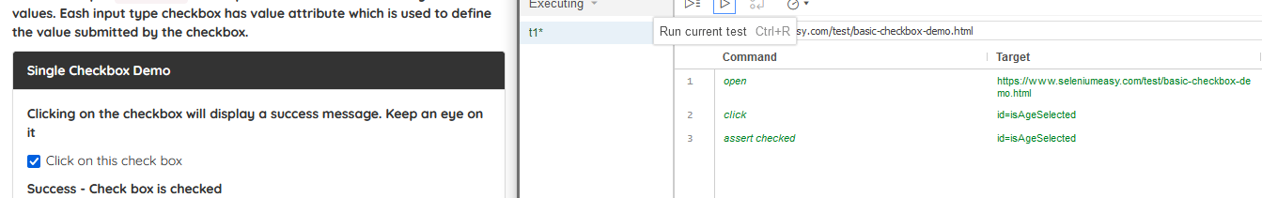
5. Assert checked

Slide 5
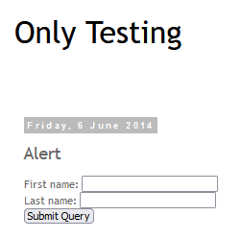
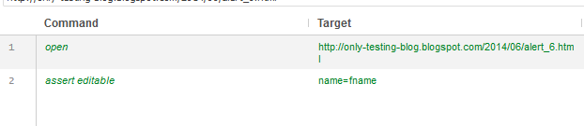
6. Assert editable

Slide 6
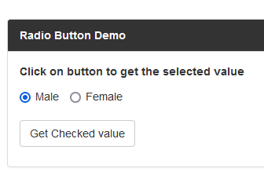
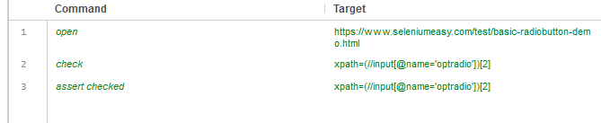
7. Radio button

Slide 7
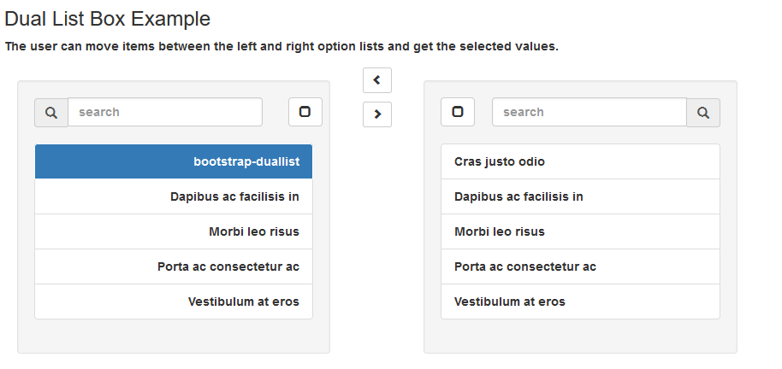
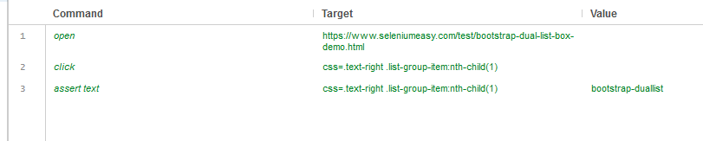
8. Assert text in a list

Slide 8
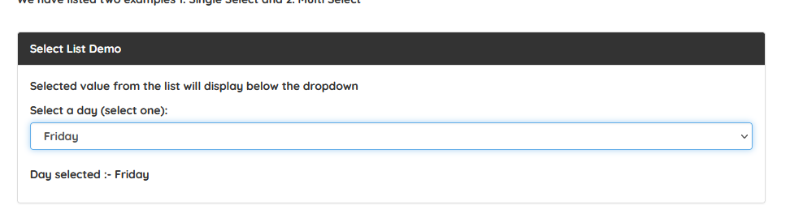
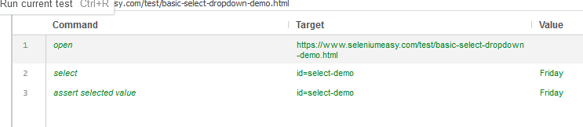
9. Assert selected value

Slide 9
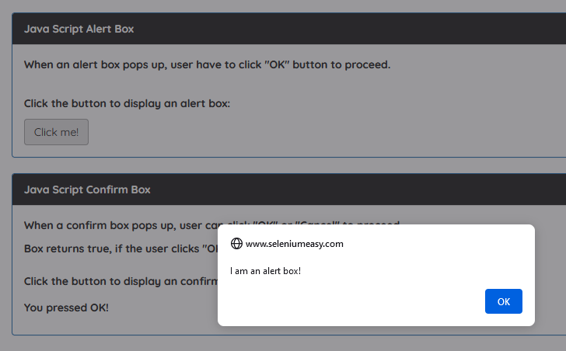
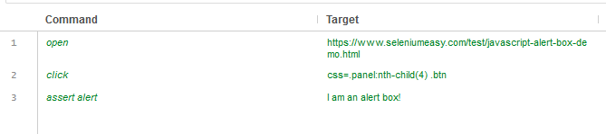
10. Assert alert

Slide 10
Other commands to check
Assert/verify not text:Confirm that the text of an element does not contain the provided value.
Assert/verify value:Confirm the (whitespace-trimmed) value of an input field (or anything else with a value parameter). For checkbox/radio elements, the value will be "on" or "off" depending on whether the element is checked or not.
Assert/verify selected value:Confirm that the value attribute of the selected option in a dropdown element contains the provided value.
Assert/verify not selected value:Confirm that the value attribute of the selected option in a dropdown element does not contain the provided value.
Assert/verify selected label:Confirm that the label of the selected option in a dropdown element contains the provided value.

Slide 11
Assert/verify checked: Confirm that the target element has been checked.
Assert/verify not checked:Confirms that the target element has not been checked.
Assert/verify editable:Confirm that the target element is editable.
Assert/verify not editable:Confirm that the target element is not editable.
Assert element present:Confirms that the target element is present somewhere on the page.
Assert element not present:Confirms that the target element is not present anywhere on the page.
Assert alert:Confirm that an alert has been rendered with the provided text.
Assert/verify confirmation:Confirms that a confirmation has been rendered.

